Slide 1
Sgroup meeting

Slide 2
Shortest path vs K-Shortest path

Slide 3
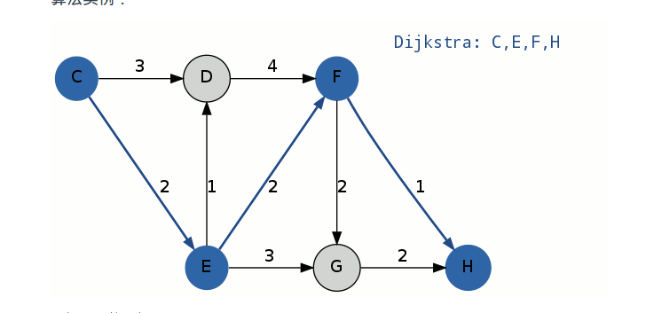
S[0] = C-E-F-H
S[1] = C-D-F-H

Slide 4
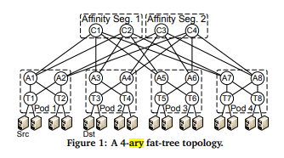

Slide 5
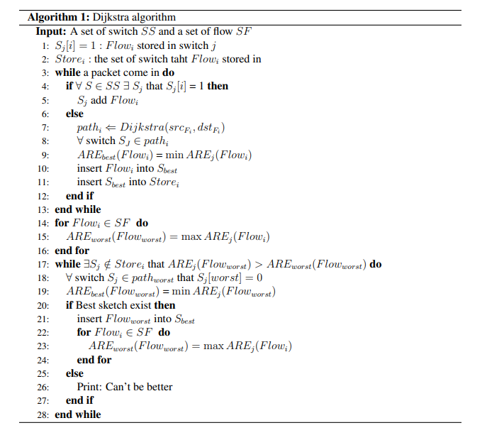
Shortest path

Slide 6
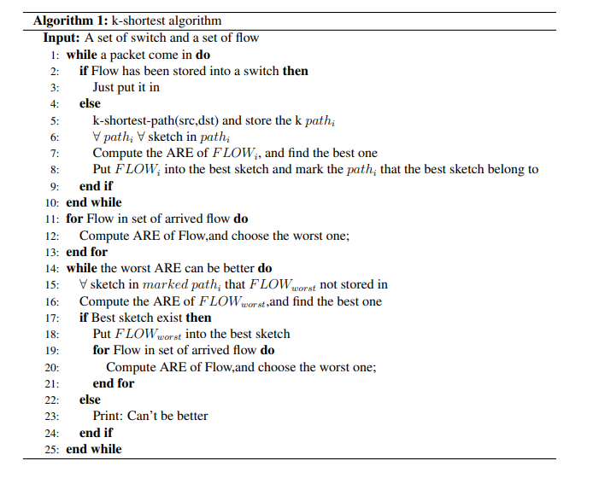
K-Shortest path

Slide 7
Shortest path vs K-Shortest path
If shortest only use the path that it choose first
Average and worst seems not very different
If shortest can choose the switch that not belong to path
Shortest can be better
Notes:
1.

